Slide 1
Pricing of iPhone
By:
Ayan Sengupta
Dattatreya Biswas

Slide 2
Contents
01
Old Story
Where does Apple stand now ?
02
Pricing Strategies
Various strategies
03
Data Analysis
Conjoint and discrete analysis
04
Optimal Price
Our recommendation

Slide 3

Old Story
Apple had a market share of 16.1% worldwide in 2015.
Smartphone shipments in India crossed the 100 million mark in 2015.
With Samsung having a greater foothold in the market with 26.8% followed by Micromax with 14.1% and Sony with 3.5%.
There has been a decline in the YOY growth in smartphones in North America and China.
Hence India, Philippines has become an important market for Apple’s growth.

Slide 4
Market Share
Current market share of Apple, Samsung and Sony in India

Slide 5
Sony Xperia
Samsung
Apple iPhone
1.8%
3.4%
26.8%
1,962,000
3,706,000
29,212,000

Slide 6
Why Pricing
1
The need for pricing a product or a service

Slide 7
Pricing strategies are used to sell a product or a service and try and maximize the profitability. It helps consumers to have an image of the standards the firm has to offer through their products, creating firms to have an exceptional reputation in the market.

Slide 8
Pricing Strategies
2
Various strategies for pricing

Slide 9
Cost is a matter of fact, price is a matter of policy.
- Unknown

Slide 10
Strategies
The following are the various ways of pricing
Value-based pricing - Price the product based on customers perceived value of the product. This is extremely beneficial for pricing a new product preventing overpricing and underpricing.

Slide 11
Value - based process
Customers
Value
Price
Cost
Product

Slide 12
Strategies contd..
2. Cost-based pricing – Product price is determined by adding a markup to a product’s unit cost(COGS). The markup price is expected to provide an acceptable return to the manufacturer. This works best when a business is in need of short term finance.

Slide 13
Cost - based process
Product
Cost
Price
Value
Customers

Slide 14
Data Analysis
3
Conjoint and Discrete analysis

Slide 15
Data Set
A total of 22 questions were asked and received 112 responses.
We performed conjoint analysis to obtained the customer perceived value for the iPhone SE smartphone.
This helped us to calculate the market share.
We found brand equity and price elasticity from Discrete choice.

Slide 16
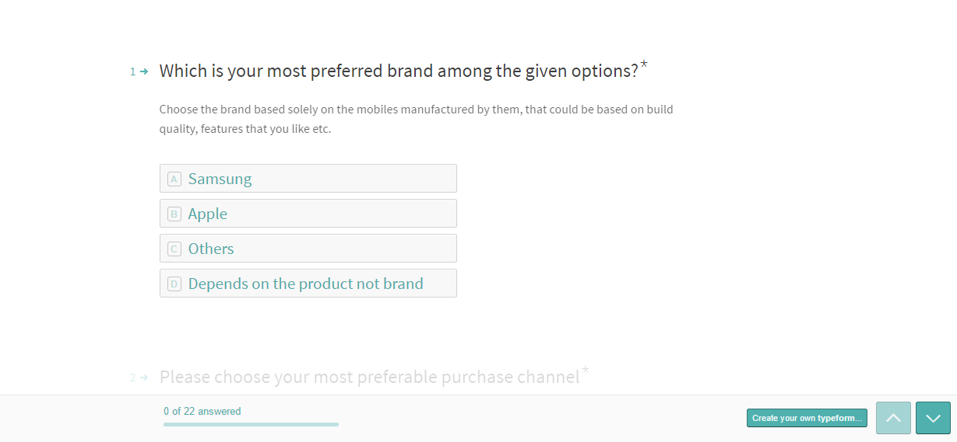
Questionnaire

Slide 17
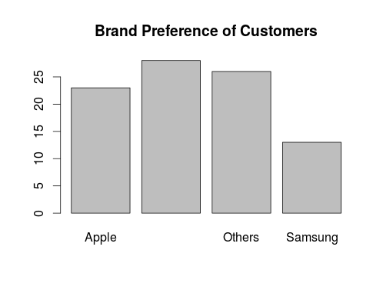
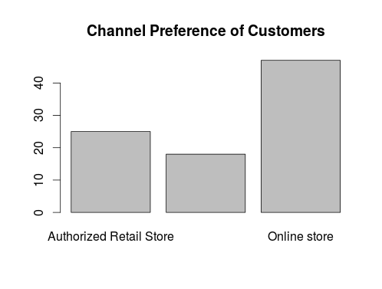
Customer Preferences

Slide 18
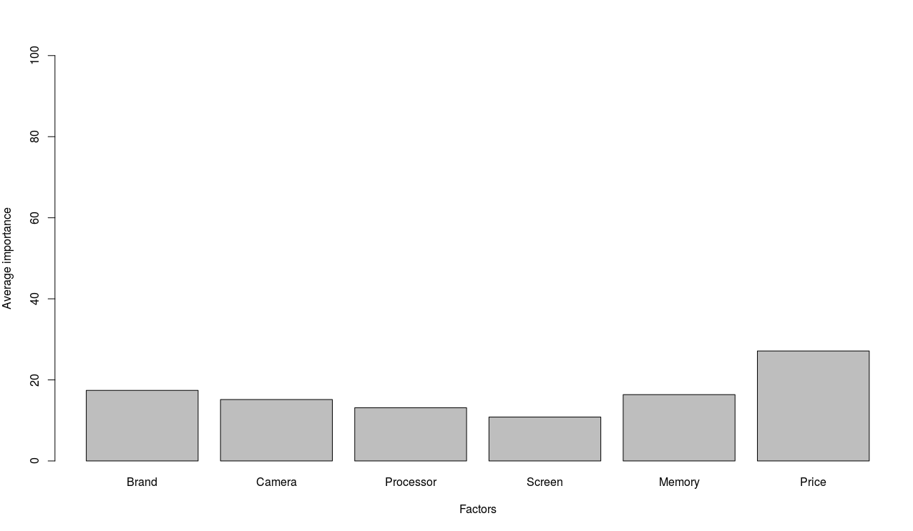
Valuation of attributes

Slide 19
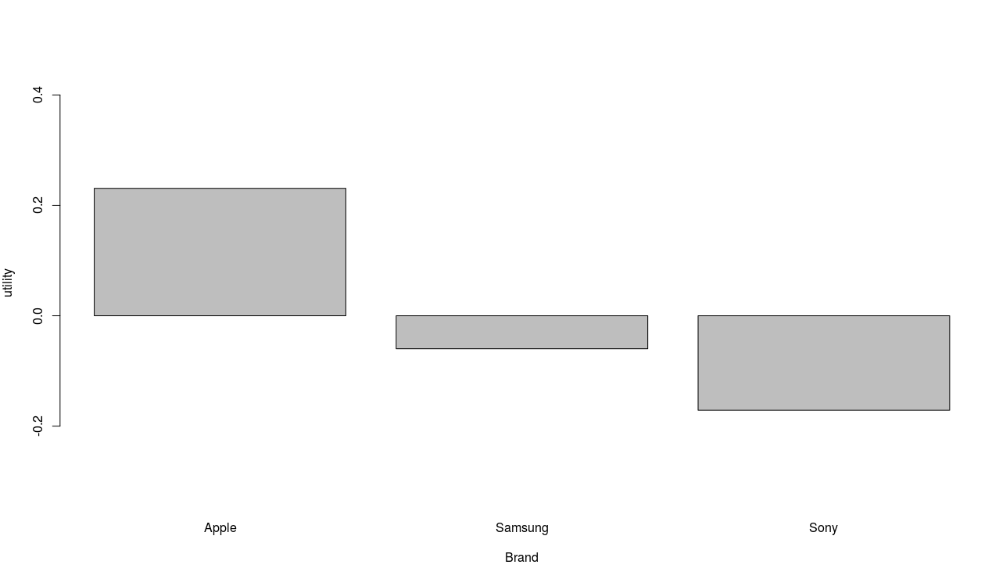
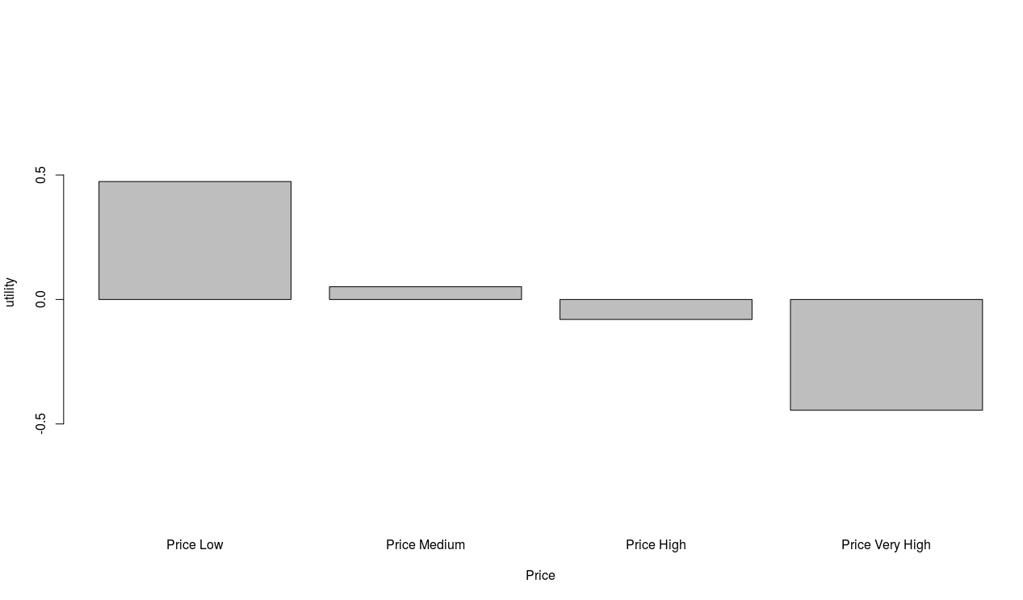
Conjoint Analysis Results

Slide 20
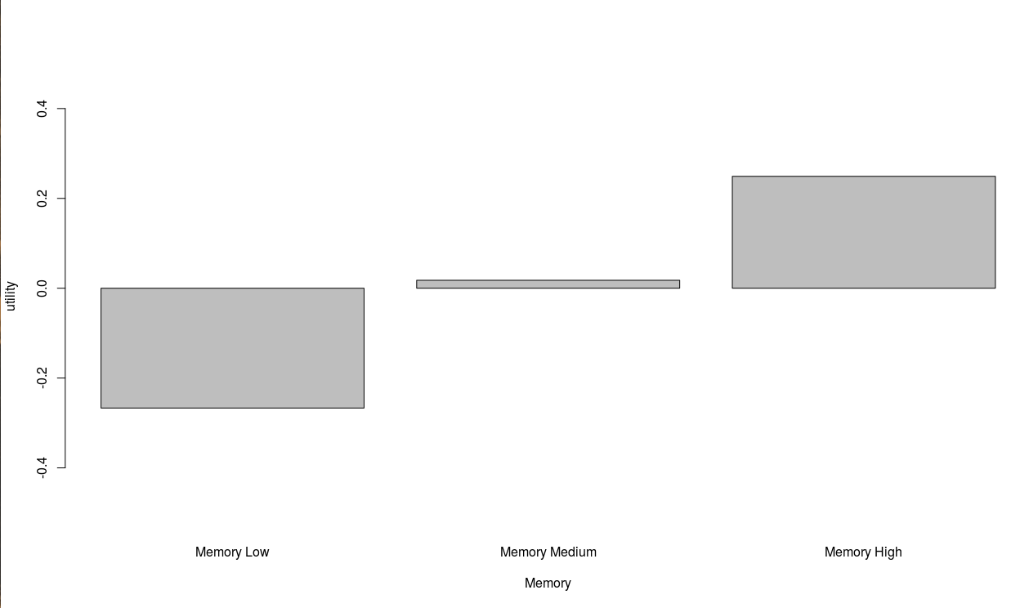
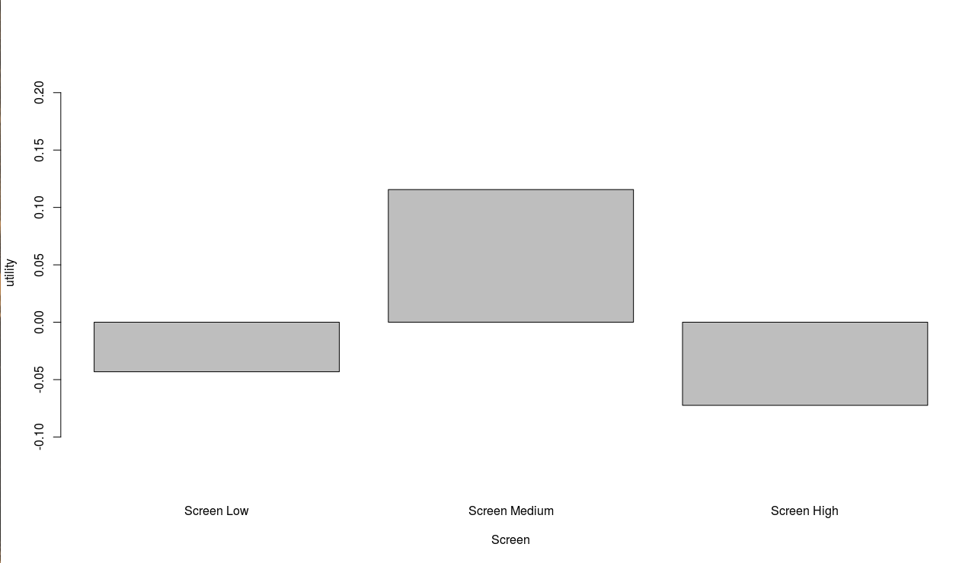
Conjoint Analysis Results

Slide 21
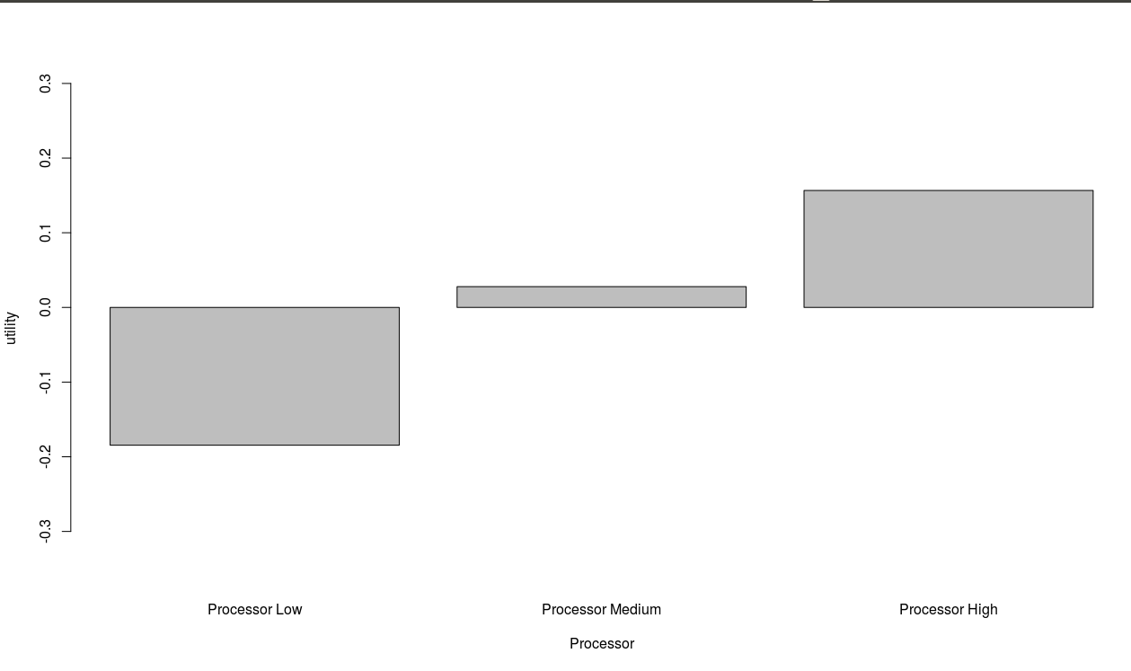
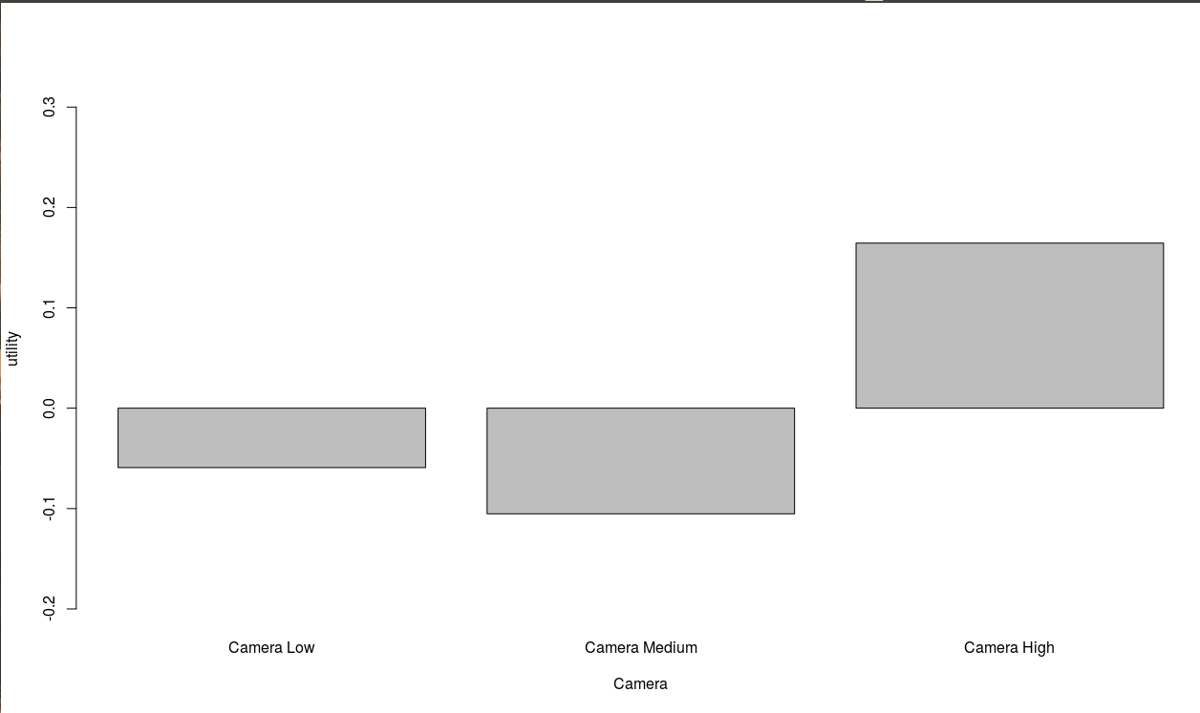
Conjoint Analysis Results

Slide 22
Optimal Price
4
Recommendations

Slide 23

Conjoint - Utility score
Sony Xperia
Samsung
Apple iPhone
2.68
2.94
3.05
0.06%
4.4%
24.8%

Slide 24
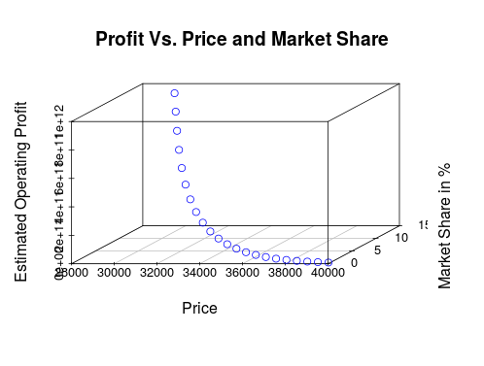
We need to set lower price to increase utility score!!
Apple iPhone

Slide 25
Discrete Choice - Brand Equity and Price Sensitivity
Sony Xperia
Samsung
Apple iPhone
4.87
2.96
3.12
-0.013
-0.012
-0.010

Slide 26
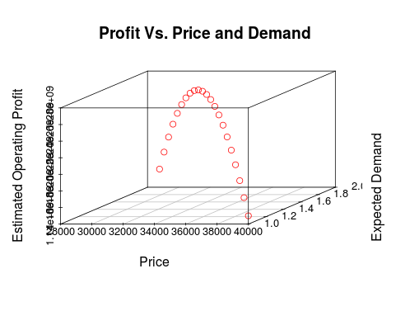
Discrete Choice - Revenue Maximization

Slide 27

Optimal Price
Our Recommendations

Slide 28
Apple iPhone SE
Apple iPhone SE
13.37%
9.12%
14,573,300
9,940,800
₹ 29,886₹
₹ 31,000₹

Slide 29
₹ 34,500
If we are focusing only on revenue and profit
25591X profit
That’s a lot of money
1.68% market share

Slide 30
THANK YOU!

